Slide 1
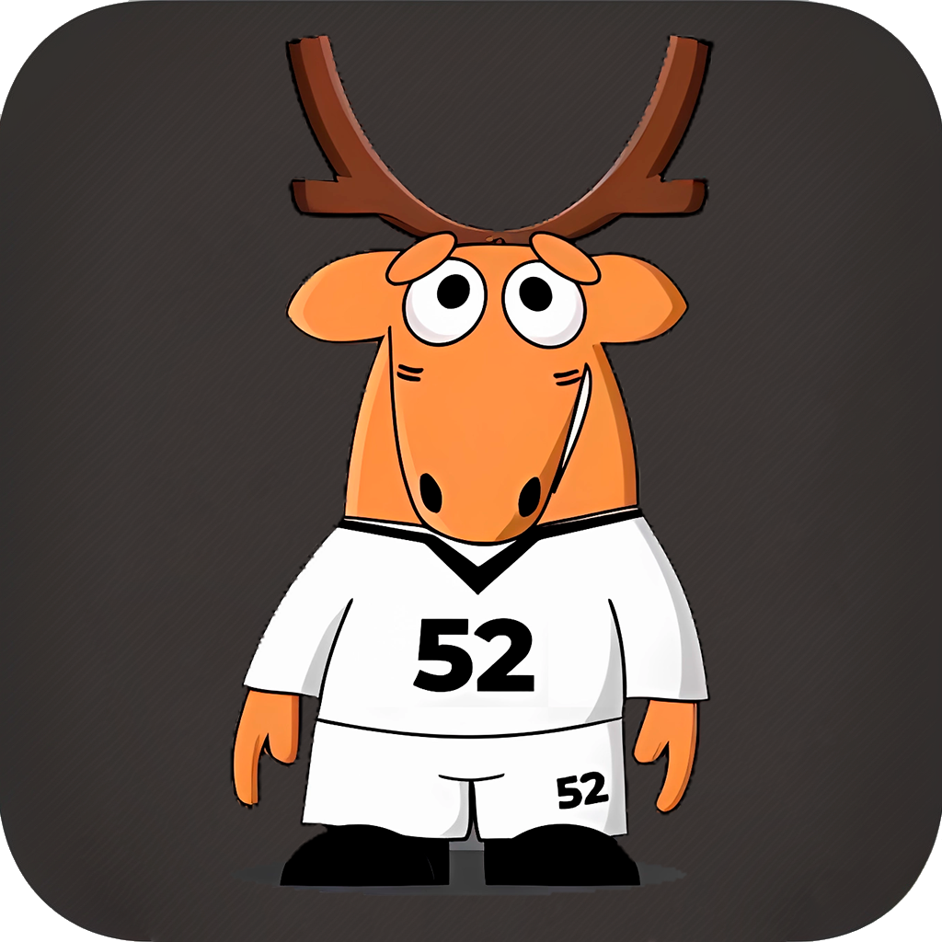
«Здоровяш» ваш личный консультант
Android App
Быстрый подбор экипировки

Slide 2
1100
117
3-й
Спортивных мероприятий проведено в 2022
Видов спорта зарегистрировано
Регион по базовым видам спорта в Приволжском ФО

Slide 3
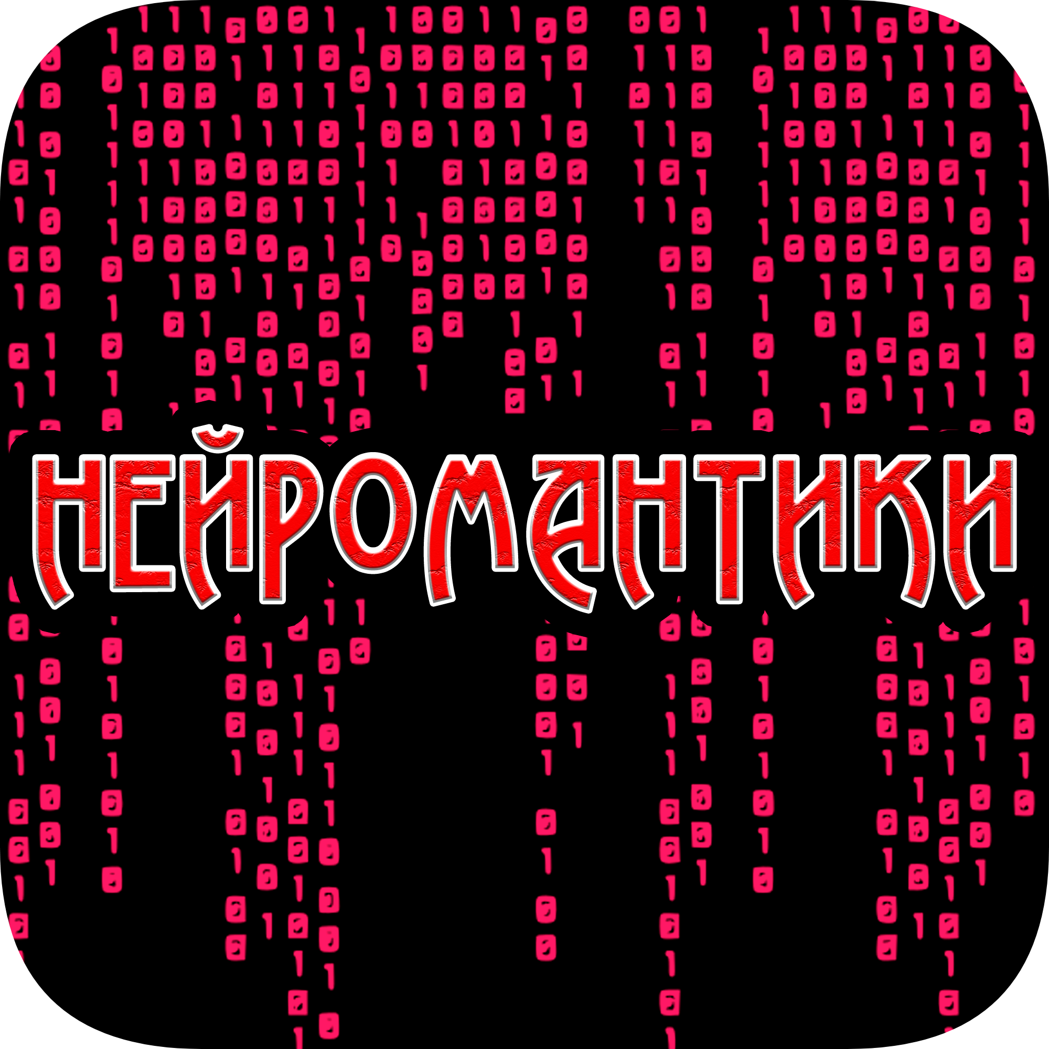

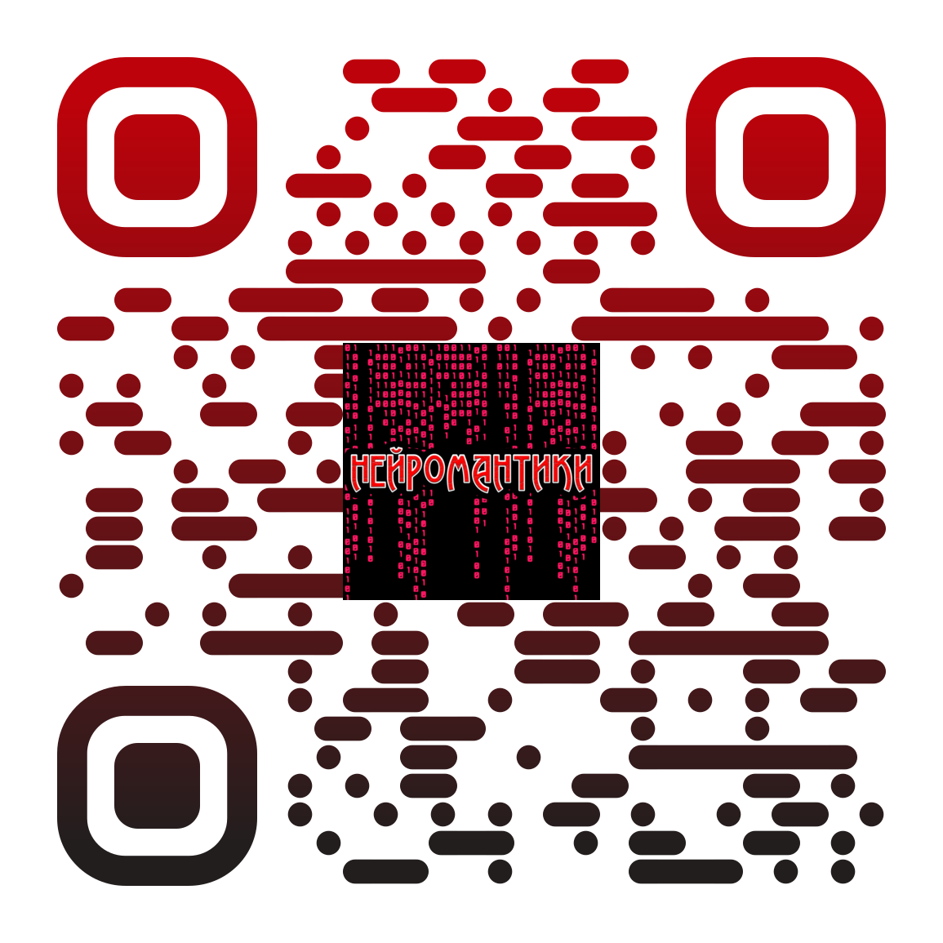
Наша команда
Г. Тобольск «Технопарк Кванториум-Тобольск»

Slide 4



Проблема…
Мотивация
Время
Экипировка

Slide 5
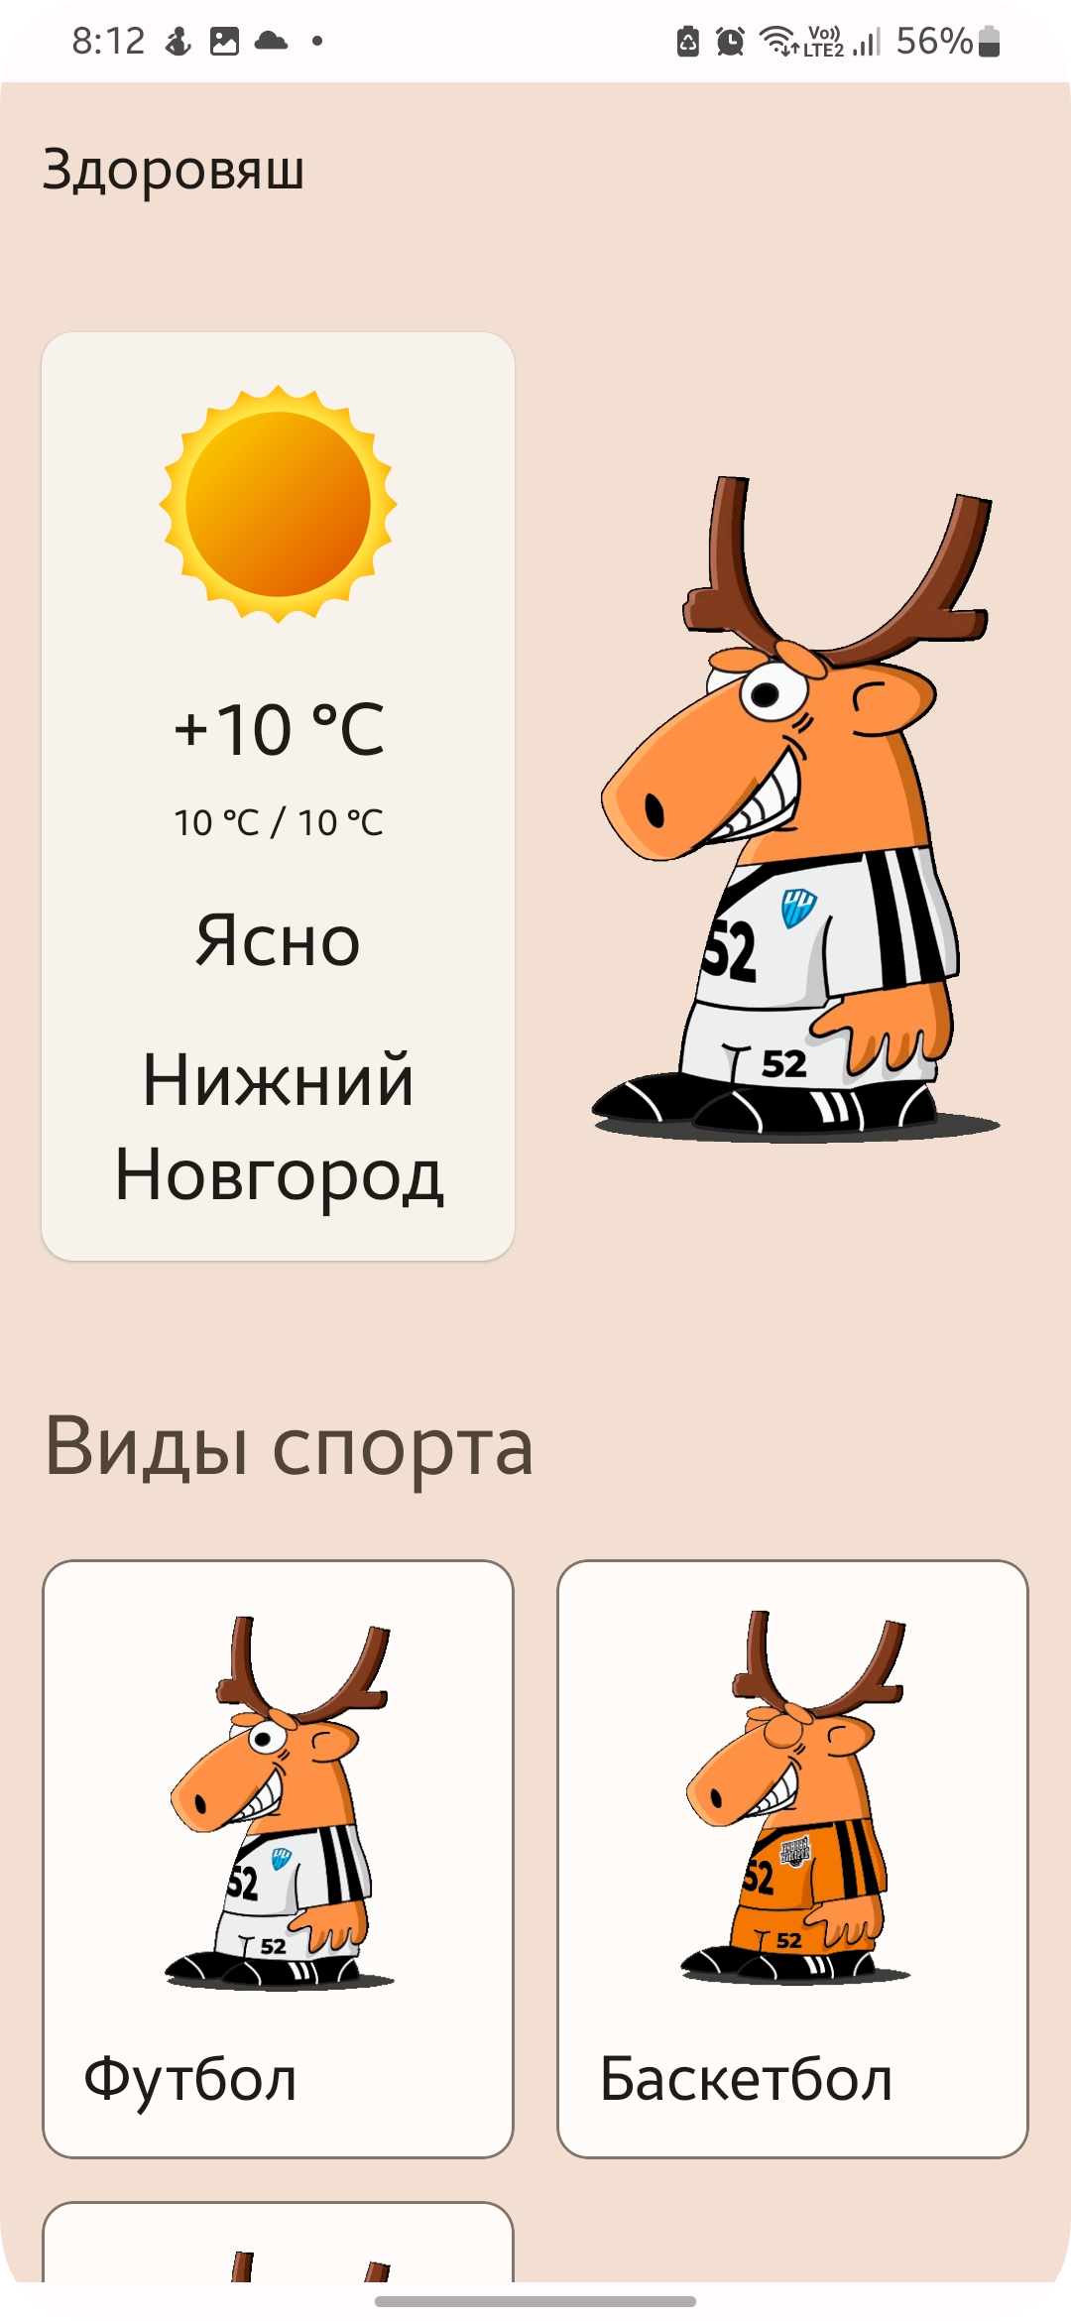
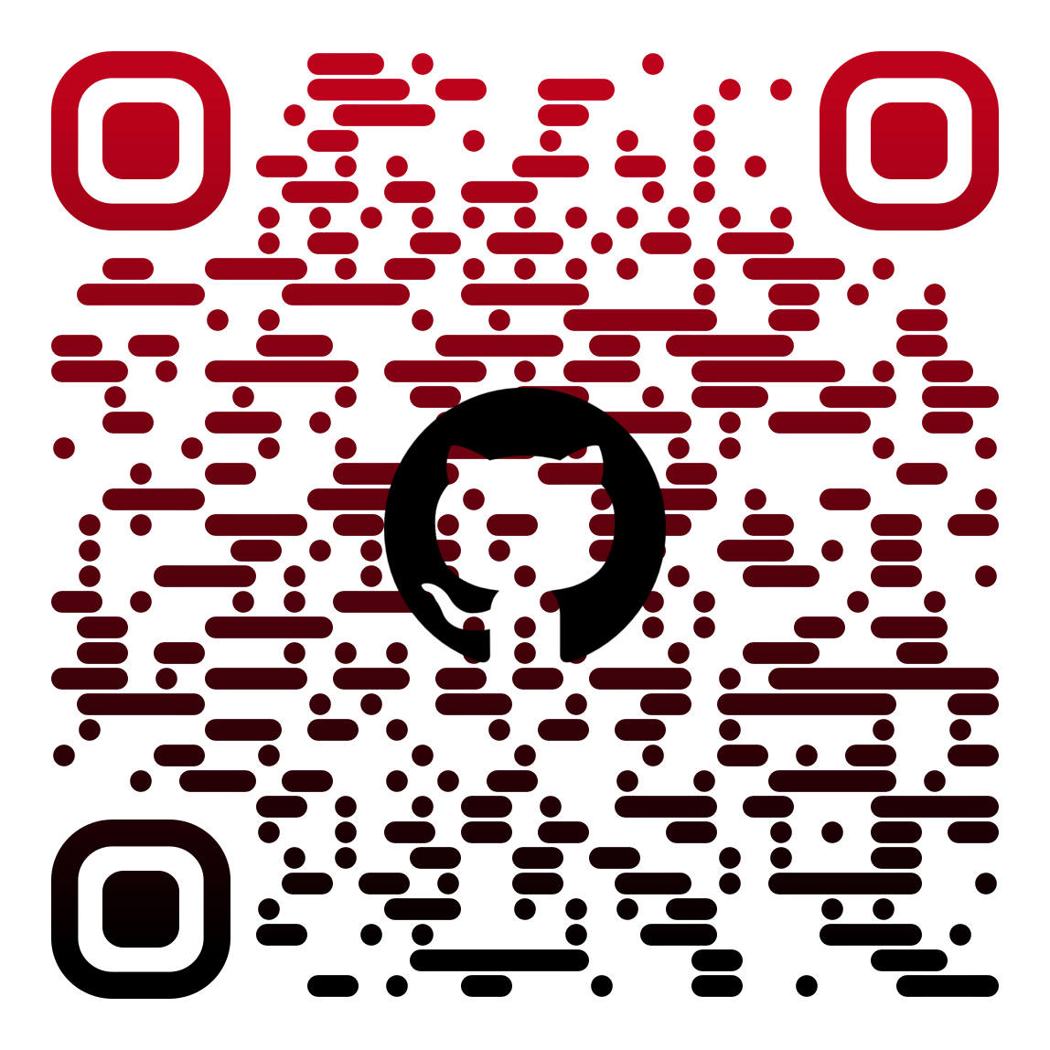
Решение
Удобное и практичное мобильное приложение для спортсменов, от мала до велика.

Slide 6
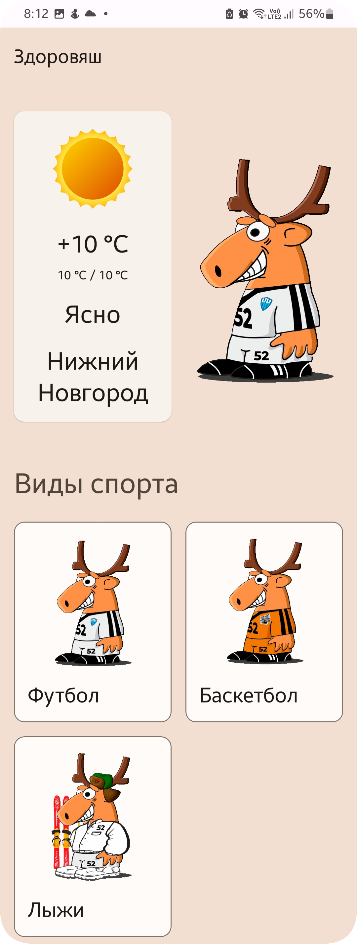
Решение
Позволяет выбирать различные виды спорта и подсказывает вам с выбором экипировки

Slide 7
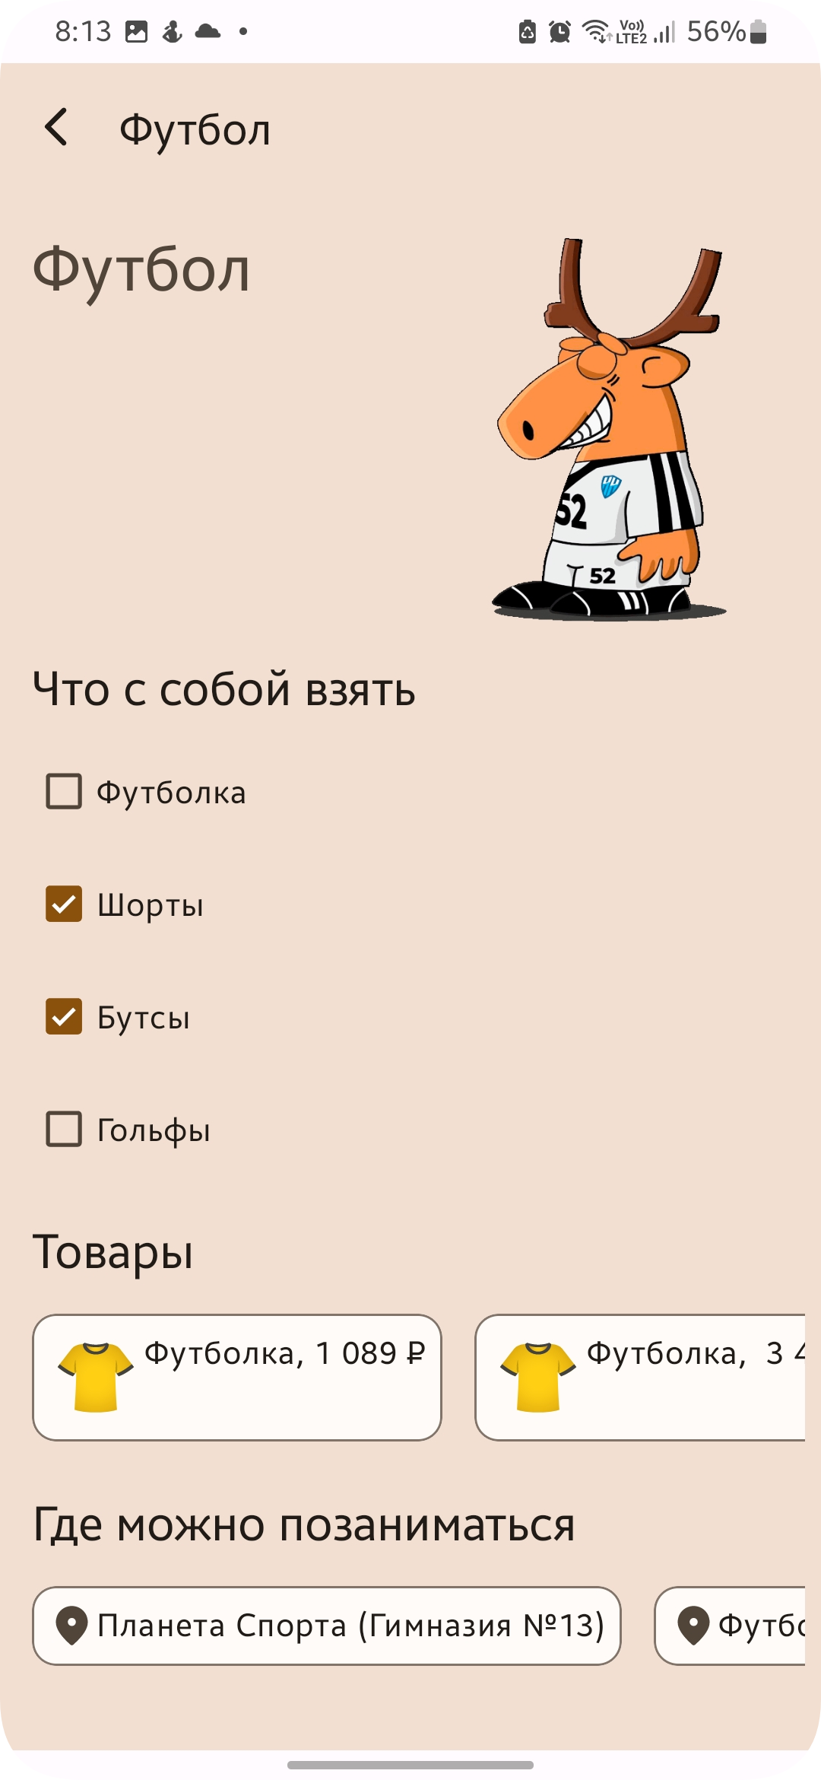
Решение
А если не знаете какую экипировку стоит купить или же где найти спортивную секцию – приложение посоветует вам

Slide 8
Архитектура
Вот как выглядит общая архитектура нашего технического решения
Приложение
Разработка APK
Сервер
Пользователь
Админ панель, БД
UX/UI, фичи

Slide 9




Серверная часть
02
03
04
VPS
Django
SQLite
REST FRAMEWORK
Удаленный хостинг-сервер
Используемый Web-фреймворк
Компактная СУБД
Используемый для REST API

Slide 10
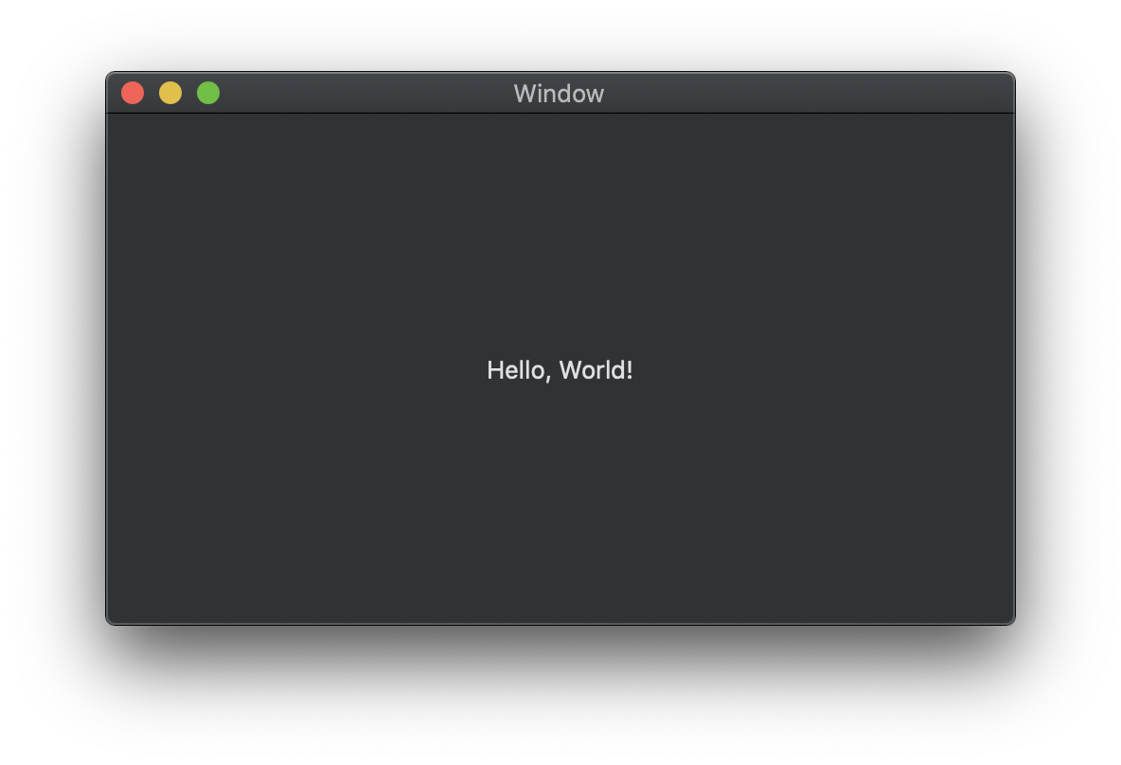
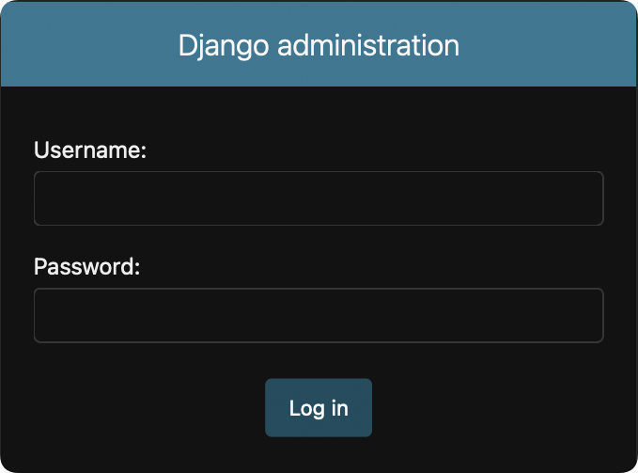
Админ панель
Одна из основных частей функционала приложения
Авторизация в админ панели

Slide 11
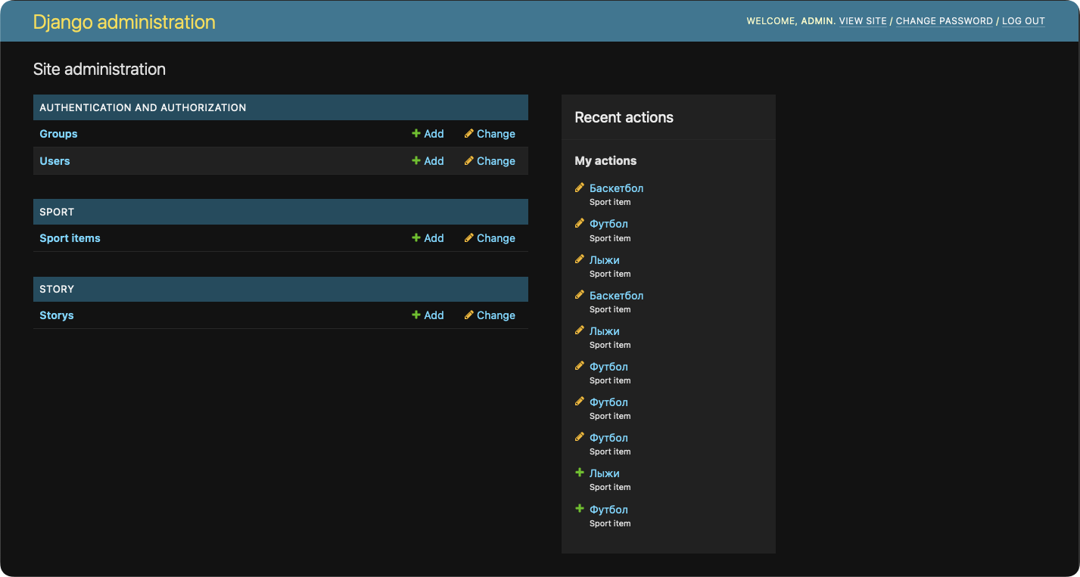

Slide 12
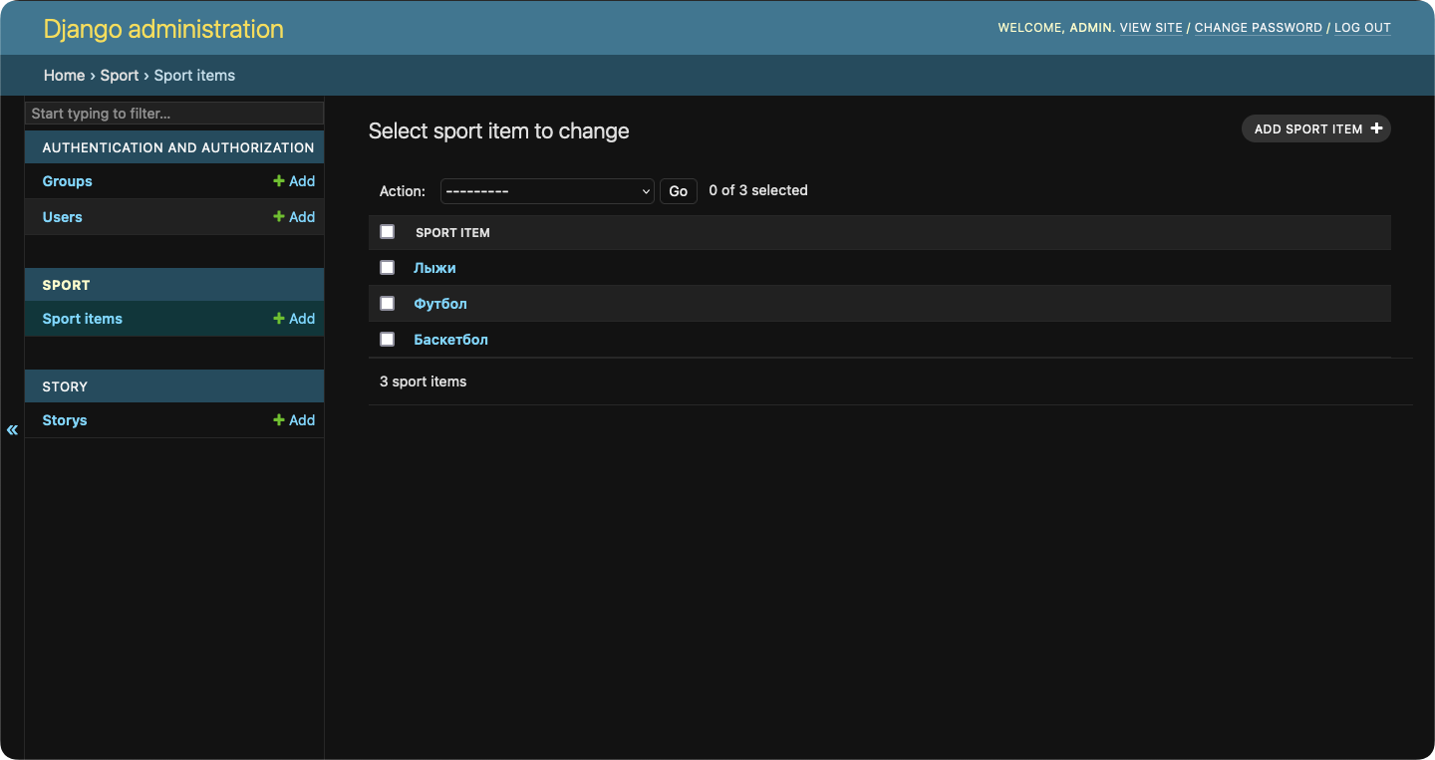

Slide 13




Технический стэк
IDE
S
Build tool
Android Studio(Canary)
Gradle
Language
T
Library сollection
Kotlin(1.8.10)
Android Jetpack

Slide 14

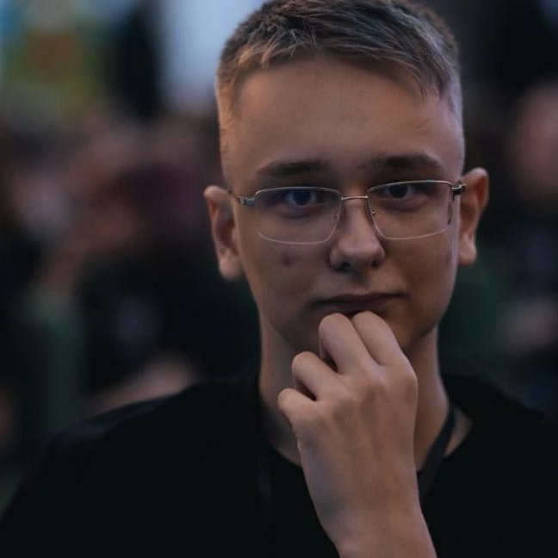

Участники
Кувалдин Саша
Копотилов Лёня
Дубина Егор
Engineering/Design/Backend 🎨📖💻
Assistant/Helper/Tester
📖📱
Chief Android Developer/Backend 💻📱🎨

Slide 15
Наша команда
Г. Тобольск «Технопарк Кванториум-Тобольск»

Slide 16
«Здоровяш» ваш личный консультант
Android App
Быстрый подбор экипировки

Slide 17
Contents of this template
Here’s what you’ll find in this Slidesgo template:
A slide structure based on a pitch deck presentation, which you can easily adapt to your needs. For more info on how to edit the template, please visit Slidesgo School or read our FAQs.
To view this template in PowerPoint with the correct fonts, download and install the fonts that we have used on your computer. You can learn how to download and install fonts here.
An assortment of graphic resources that are suitable for use in the presentation can be found in the alternative resources slides.
A thanks slide, which you must keep so that proper credits for our design are given.
A resources slide, where you’ll find links to all the elements used in the template.
Instructions for use.
Final slides with:
The fonts and colors used in the template.
A selection of illustrations. You can also customize and animate them as you wish with the online editor. Visit Storyset to find more.
More infographic resources, whose size and color can be edited.
Sets of customizable icons of the following themes: general, business, avatar, creative process, education, help & support, medical, nature, performing arts, SEO & marketing, and teamwork.
You can delete this slide when you’re done editing the presentation.

Slide 18
Table of contents
01
02
03
04
Problem vs. solution
Product overview
Market & competition
Business model
You can describe the section here
You can describe the section here
You can describe the section here
You can describe the section here

Slide 19
Introduction
You can give a brief description of the topic you want to talk about here. For example, if you want to talk about Mercury, you can say that it’s the smallest planet in the entire Solar System

Slide 20
01
Problem
vs. solution
You can enter a subtitle here if you need it

Slide 21
Them vs. us
Augmented reality
Virtual reality
Mercury is the closest planet to the Sun and the smallest one of them all—it’s only a bit larger than the Moon
Venus has a beautiful name and is the second planet from the Sun. It’s hot and has a poisonous atmosphere

Slide 22
Awesome words

Slide 23
02
Product overview
You can enter a subtitle here if you need it

Slide 24
Product overview
Saturn
Mercury
Venus
Mars
Jupiter
Neptune
It’s composed of hydrogen and helium
It’s the closest planet to the Sun
Venus is the second planet from the Sun
Mars is actually a very cold place
Jupiter is the biggest planet of them all
It’s the farthest planet from the Sun

Slide 25
Our plans
Basic
Jupiter is the biggest planet of them all
Characteristic Characteristic Characteristic
$70
Standard
The Sun is the star at the center of the Solar System
Characteristic Characteristic Characteristic
$120
Premium
Despite being red, Mars is actually a cold place
Characteristic Characteristic Characteristic
$150

Slide 26
489,236
Big numbers catch your audience’s attention

Slide 27
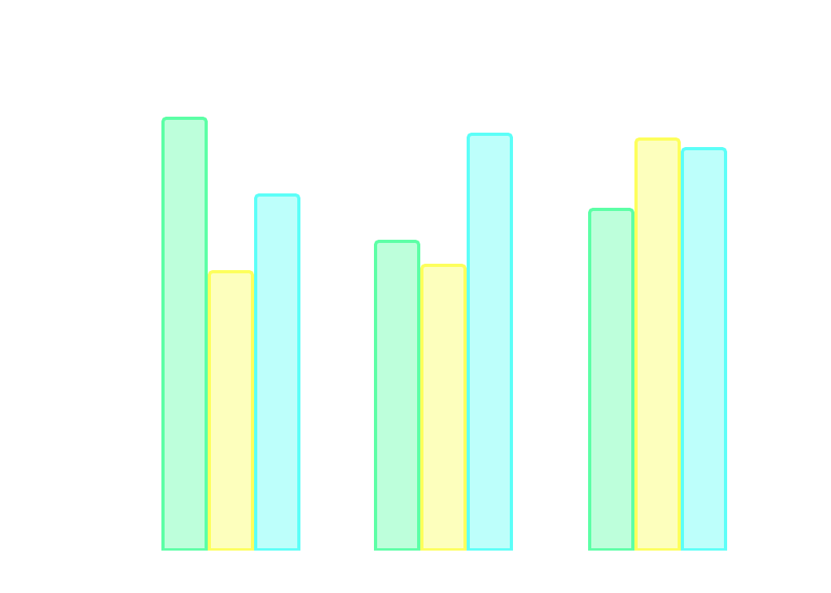
This is a graph
Venus
Mars
Ceres
$1,850
Average user savings per deal
$516,500
Annual revenue
28,362
Total app downloads
2019
2020
2021
Follow the link in the graph to modify its data and then paste the new one here. For more info, click here

Slide 28
Reviews
John James
Lisa Patterson
“Mars is full of iron oxide dust, which gives the planet its reddish cast”
“Jupiter is a gas giant and the biggest planet in the Solar System”

Slide 29
Awards
Mars
Mercury
Venus
Despite being red, Mars is actually a cold place. It’s full of iron oxide dust
It’s the closest planet to the Sun and the smallest one in the Solar System
Venus has a beautiful name and is the second planet from the Sun

Slide 30

A picture is worth a thousand words

Slide 31
Market size
36%
64%
Jupiter
Venus
Jupiter is a gas giant and the biggest planet in the Solar System
Venus has a beautiful name and is the second planet from the Sun

Slide 32
Target
21-32
70%
33-45
61%
46-56
39%
Gender
Age range
57%
43%
Hobbies
Mars is actually a cold place
Earth is where we all live
Saturn has several rings

Slide 33
Main competitors
Mercury
Venus
Jupiter
Neptune
It’s the closest planet to the Sun and the smallest one in the Solar System
Venus has a beautiful name and is the second planet from the Sun
Jupiter is a gas giant and the biggest planet in the Solar System
It's the fourth largest object by diameter in the Solar System

Slide 34
Business model
Marketing | Training | Assessment | Technology
Jupiter is a gas giant and the biggest planet in the Solar System | Neptune is the farthest planet from the Sun. It’s cold there | Despite being red, Mars is actually a very cold place to live | Earth is the only planet that harbors life in the Solar System
Saturn is a gas giant | Mercury is small | Pluto is small | Ceres is small

Slide 35

A picture always reinforces the concept
Images reveal large amounts of data, so remember: use an image instead of a long text. Your audience will appreciate it

Slide 36
Project timing
Jupiter is the biggest planet of them all
The Moon is Earth’s only natural satellite
Phase 2
Phase 4
Phase 1
Phase 3
Mars is a cold place, full of iron oxide dust
Saturn is a gas giant and has several rings

Slide 37
—Someone Famous
“This is a quote, words full of wisdom that someone important said and can make the reader get inspired.”

Slide 38

Predicted growth
Mercury
It’s the closest planet to the Sun and the smallest one of them all
+$500,000
Expected income for 2022
21,500
New users next year
Follow the link in the graph to modify its data and then paste the new one here. For more info, click here

Slide 39

Investment
$7,750
$6,900
Saturn is a gas giant and has several rings
Ceres is in the main asteroid belt
$5,700
$8,500
Jupiter is the biggest planet of them all
The Moon is Earth’s only natural satellite
Follow the link in the graph to modify its data and then paste the new one here. For more info, click here

Slide 40
Thanks!
Do you have any questions?
youremail@freepik.com
+91 620 421 838
yourcompany.com
Please keep this slide for attribution

Slide 41
Virtual & augmented reality icon pack

Slide 42
Alternative resources

Slide 43
Alternative resources
Here’s an assortment of alternative resources whose style fits the one of this template:
Vectors
People using augmented reality on smartphones
People using augmented reality on smartphones I

Slide 44
Resources
Did you like the resources on this template? Get them for free at our other websites:
Vectors
People using augmented reality on smartphones
People using augmented reality on smartphones I
People using augmented reality on smartphones II
People using augmented reality on smartphones III
Icons
Virtual and augmented reality icon pack

Slide 45
Instructions for use
If you have a free account, in order to use this template, you must credit Slidesgo by keeping the Thanks slide. Please refer to the next slide to read the instructions for premium users.
As a Free user, you are allowed to:
- Modify this template.
- Use it for both personal and commercial projects.
You are not allowed to:
- Sublicense, sell or rent any of Slidesgo Content (or a modified version of Slidesgo Content).
- Distribute Slidesgo Content unless it has been expressly authorized by Slidesgo.
- Include Slidesgo Content in an online or offline database or file.
- Offer Slidesgo templates (or modified versions of Slidesgo templates) for download.
- Acquire the copyright of Slidesgo Content.
For more information about editing slides, please read our FAQs or visit Slidesgo School:
https://slidesgo.com/faqs and https://slidesgo.com/slidesgo-school

Slide 46
Instructions for use (premium users)
As a Premium user, you can use this template without attributing Slidesgo or keeping the "Thanks" slide.
You are allowed to:
Modify this template.
Use it for both personal and commercial purposes.
Hide or delete the “Thanks” slide and the mention to Slidesgo in the credits.
Share this template in an editable format with people who are not part of your team.
You are not allowed to:
Sublicense, sell or rent this Slidesgo Template (or a modified version of this Slidesgo Template).
Distribute this Slidesgo Template (or a modified version of this Slidesgo Template) or include it in a database or in any other product or service that offers downloadable images, icons or presentations that may be subject to distribution or resale.
Use any of the elements that are part of this Slidesgo Template in an isolated and separated way from this Template.
Register any of the elements that are part of this template as a trademark or logo, or register it as a work in an intellectual property registry or similar.
For more information about editing slides, please read our FAQs or visit Slidesgo School:
https://slidesgo.com/faqs and https://slidesgo.com/slidesgo-school

Slide 47
Fonts & colors used
This presentation has been made using the following fonts:
Montserrat
(https://fonts.google.com/specimen/Montserrat)
Barlow Semi Condensed
(https://fonts.google.com/specimen/Barlow+Semi+Condensed)
#1e1e1e
#ffffff
#2d2d2d
#f3f3f3
#b7b7b7
#955cff
#fdff5c
#5cfff8
#5cffa6
#ff5c5c

Slide 48





Storyset
Create your Story with our illustrated concepts. Choose the style you like the most, edit its colors, pick the background and layers you want to show and bring them to life with the animator panel! It will boost your presentation. Check out how it works.
Pana
Amico
Bro
Rafiki
Cuate

Slide 49
Use our editable graphic resources...
You can easily resize these resources without losing quality. To change the color, just ungroup the resource and click on the object you want to change. Then, click on the paint bucket and select the color you want. Group the resource again when you’re done. You can also look for more infographics on Slidesgo.

Slide 52
JANUARY
FEBRUARY
MARCH
APRIL
MAY
JUNE
PHASE 1
Task 1
Task 2
PHASE 2
Task 1
Task 2
JANUARY
FEBRUARY
MARCH
APRIL
PHASE 1
Task 1
Task 2

Slide 55
...and our sets of editable icons
You can resize these icons without losing quality.
You can change the stroke and fill color; just select the icon and click on the paint bucket/pen.
In Google Slides, you can also use Flaticon’s extension, allowing you to customize and add even more icons.

Slide 56
Educational Icons
Medical Icons

Slide 57
Business Icons
Teamwork Icons

Slide 58
Help & Support Icons
Avatar Icons

Slide 59
Creative Process Icons
Performing Arts Icons

Slide 60
Nature Icons

Slide 61
SEO & Marketing Icons

Slide 62


